Slide 1
Artificial Intelligence
Artificial Intelligence: means getting a computer to mimic human behaviour in some way.
While some people falsely consider AI a technology, the more accurate approach would be seeing it as a broad concept in which machines can deal with tasks in a way we would call intelligent or smart.

Slide 2
Machine Learning
So is Artificial Intelligence and Machine learning the same? Not really. Artificial Intelligence is a broader concept while machine learning is a very common application of AI.
For example: If we give computer information about weather patterns for the last few years. The computer can use “machine learning” algorithms to predict the weather condition tomorrow or the day after and so on.

Slide 3
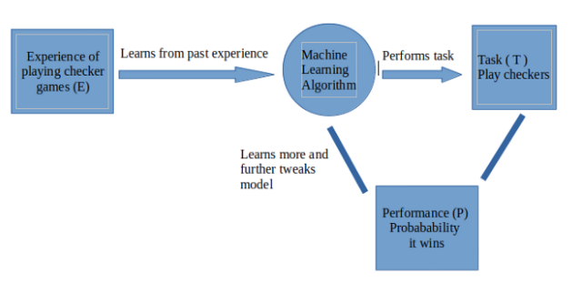
A more formal definition of Machine Learning
A computer program is said to learn from experience E with respect to some task T and some performance measure P, if its performance on T, as measured by P, improves with experience E.
Task: Play checkers
Experience: Past checkers games
Performance: Winning/Losing

Slide 4
Supervised and Unsupervised
Broadly a ML problem can be classified into supervised and unsupervised problems.
Supervised: we train a model with data which is already labelled or in simpler words we have a dataset which contains information about what the actual output must look like. So once the model learns from this “Training data” it tries to predict the output for a new set of examples by establishing a relationship between the input and output.
Unsupervised: training of machine using information that is neither classified nor labelled and allowing the algorithm to act on that information without guidance. Here the task of machine is to group unsorted information according to similarities, patterns and differences without any prior training of data.

Slide 5
Regression and Classification
Supervised learning problems can be further classified into regression and classification problems
Regression: Whenever we are trying to predict results within a continuous output, meaning we are trying to map some input variables to some continuous function. For example: Given the characteristics of a mobile phone, we need to predict the approximate price of the mobile phone.
Classification: Whenever we are trying to classify the output into specific categories, meaning we need to map some input variables to output some discrete values. For example: Given an image of an animal, we need to classify into whether its a cat or a dog.

Slide 6

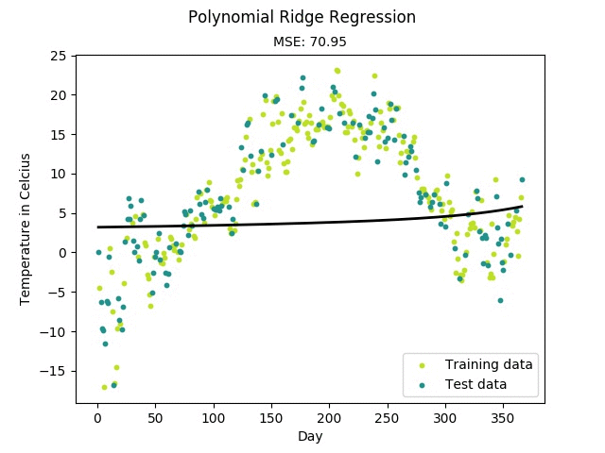

Clustering
Classification
Regression

Slide 7
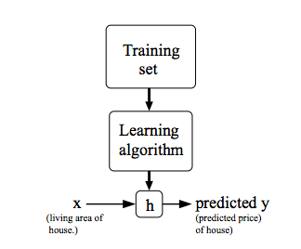
Linear Regression
As the name suggests, a linear regression model tries to map the output variable with the input variable in a linear fashion. In rather simpler words, a linear regression model assumes a linear relationship between a dependent, continuous variable Y with one or more independent variables called X.
Y = MX + C
Here,
Y = dependent, continuous variable (eg: cost of a house)
X = independent (eg: square feet area of house)
M, C = weight and bias terms of the linear regression model

Slide 8
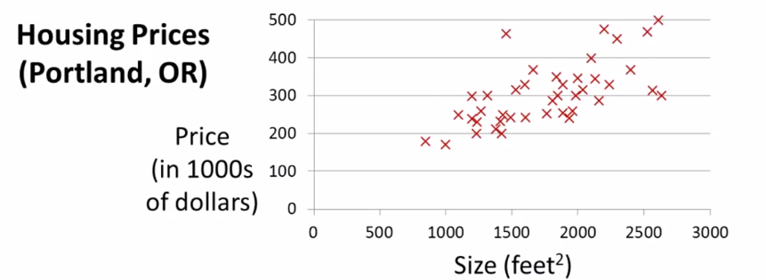
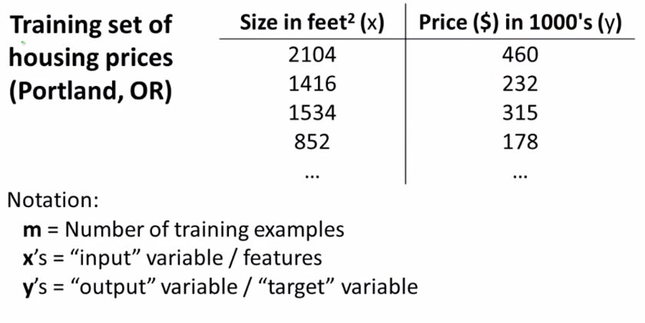
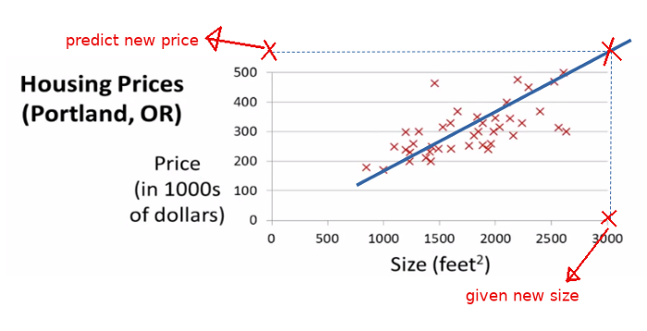
BUT, How do you determine the best fit line
(or)
How do you find the values of m and c for optimal solutions

Slide 9
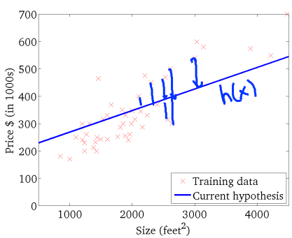
Cost function
we need to have a metric to evaluate how well our model is fitting the given data. This metric is modelled into a function which we call a cost function. So the cost function defines how much the given line is deviating from the points in the given dataset.
We need to model our cost function in terms of our parameters which define the line so that we can find the “optimal” set of parameters when the cost is minimum.

Slide 10
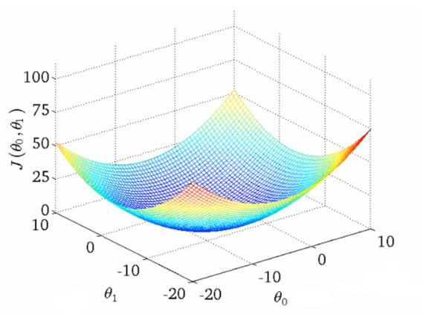
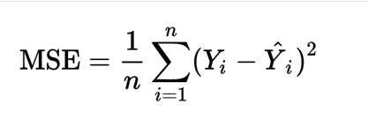
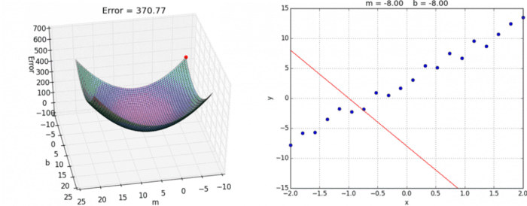
Mean Squared Error
predicted
groundtruth

Slide 11
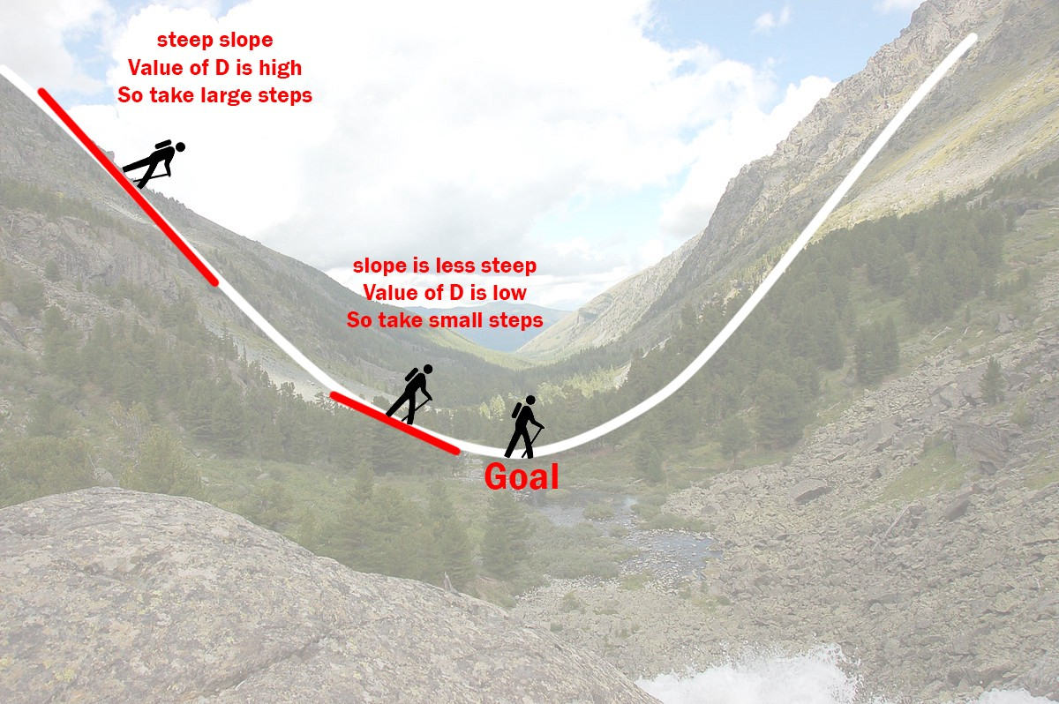
Gradient Descent
Let’s imagine a valley where a person at the top has to reach the bottom of it and the person has no clue as to which direction the minima is.

Slide 12
When the person is on the left of the minima, the slope at the point at which he is standing is negative. Now suppose we subtract this negative value from the value of m and c at that particular point we can see that m and c would increase (subtracting a negative value basically adds it) and hence the person would move closer to the minima (i.e) to the right.
Similarly, if the person is on the right of the minima the slope at that point is positive and hence by subtracting this positive value from m and c, the person would move towards the minima (i.e) to the left.
As the person moves closer and closer to the minima the slope would decrease and hence the person would take smaller and smaller steps. Hence the person can’t reach the exact minima but go as close as possible to it.

Slide 13
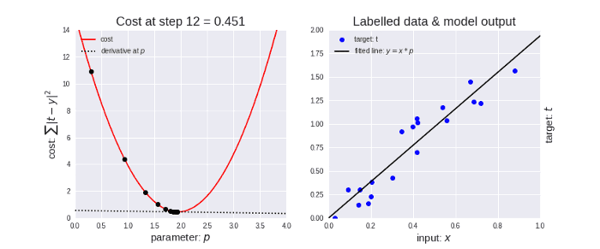
Hence the aim of a linear regression model should be to reduce the cost as much as possible but since it can never reach the absolute minima, we can stop training once the cost is saturated.
(i.e the model can’t improve further).

Slide 14
Some important points
Learning rate: whenever we update the values of m and c, we must ensure that we take sufficiently small steps so that it wouldn't overshoot or cross the minima and move to the other side. For example, if we are at the highest point on the peak the value of the slope at that point is very high and hence there is a high possibility that if we don’t scale down the step size we can overshoot and cross the minima.
Initial values of m and c: Frankly speaking, there is no ideal initial value. A common practise is to randomly initialize the starting values and proceed from there. What happens when you initialize the values to 0???
Multiple optimas: We have taken a simple ideal case, where there are no local minimas. There is high chance that the model can converge to these local minimas which is not entirely useful in our case.

Slide 15
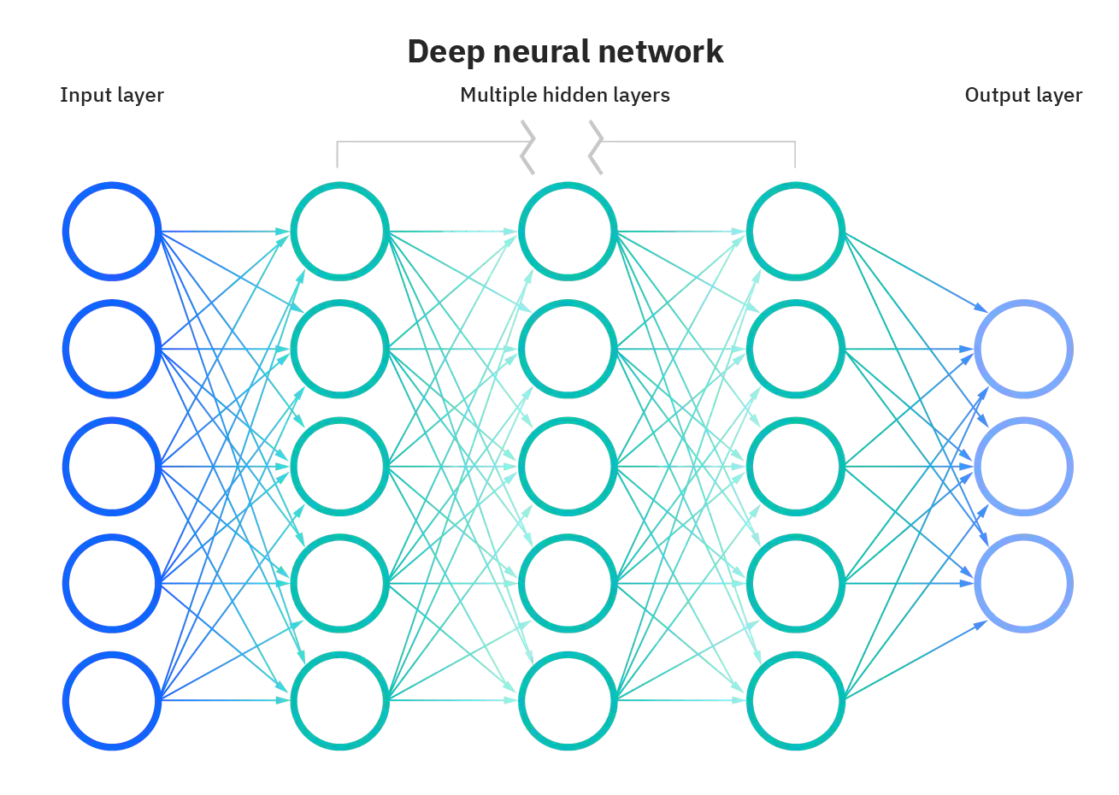
Neural Networks
Neural Networks (also called ANNs) are the fundamental units in Deep Learning. When broken down, it can be understood as multiple linear regression units with some functions (also called activation functions) which help model complex mappings between the input and output

Slide 16
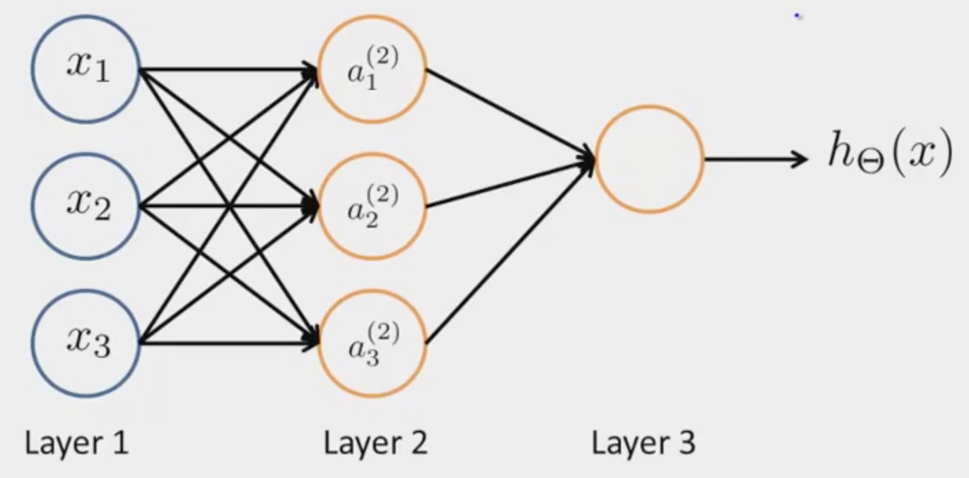
Neural Networks
A Neural Network consists of Input, Hidden and an Output Layer
Input Layer
Hidden Layer
Output Layer

Slide 17
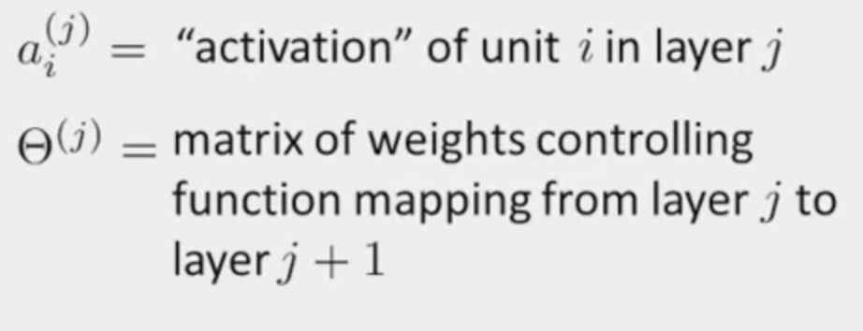
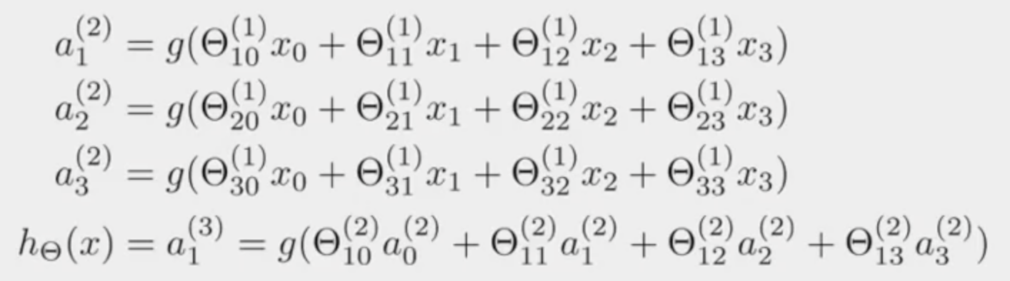

Slide 18
Forward Propagation : Vectorized Implementation

Slide 19
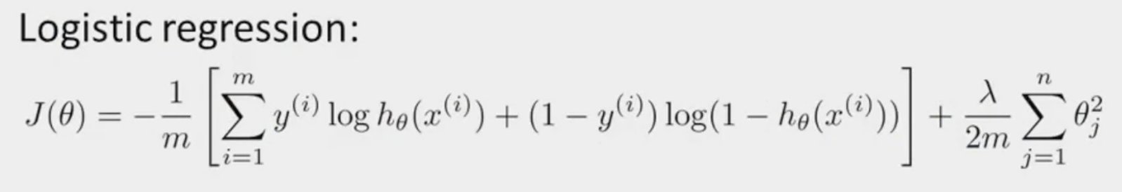
Loss Function
The loss function is the technique of evaluating “the performance of our algorithm/model”. It takes both predicted outputs by the model and actual outputs and calculates how much wrong the model was in its prediction. It outputs a higher number if our predictions differ a lot from the actual values.

Slide 20
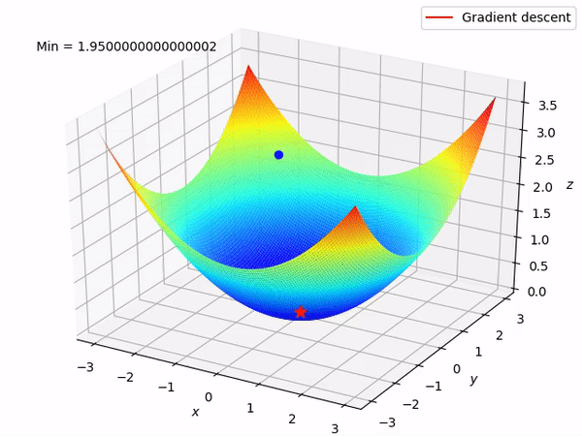
Gradient Descent

Slide 21
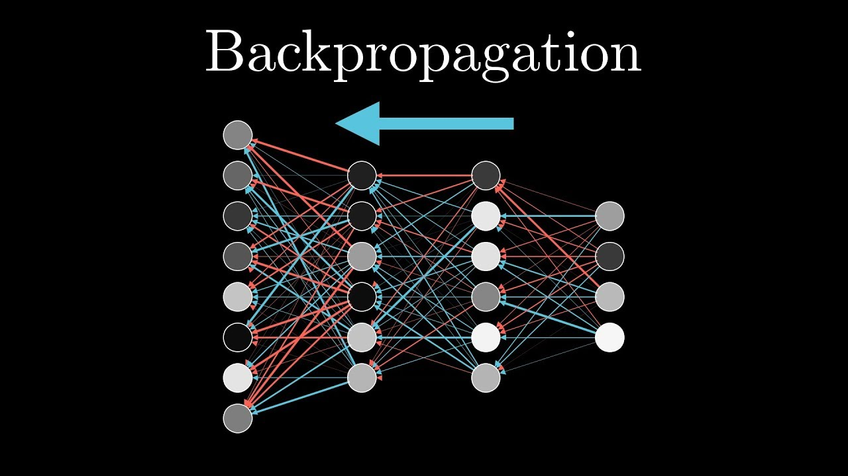
Backpropagation
Backpropagation, short for "backward propagation of errors," is an algorithm for supervised learning of artificial neural networks using gradient descent. Given an artificial neural network and an error function, the method calculates the gradient of the error function with respect to the neural network’s weights.

Slide 22
Normalisations
Sometimes while calculating the gradients, they can blow up or vanish to 0 because you apply chain rule so many times that the gradients can sometimes become 0 or blow up to infinity. To avoid this we normalise the neurons( values in the hidden layers ) so that they always stay between some certain values like 0 and 1 so that this helps to tackle the problem of vanishing or exploding gradients. Normalisation also helps to train faster.
There are different types of normalisation like Batch Normalisation, Layer Normalisation, Instance Normalisation etc. Batch Normalisation is used 90% of the time.

Slide 23
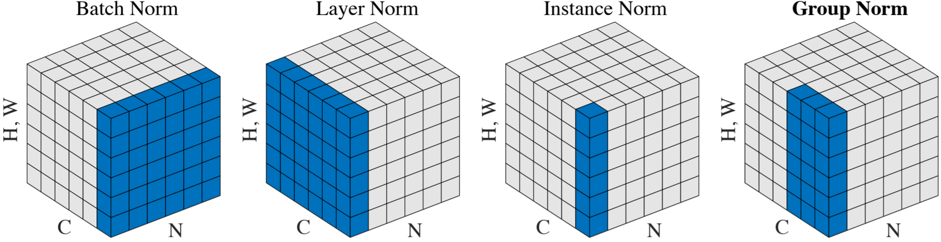

Slide 24
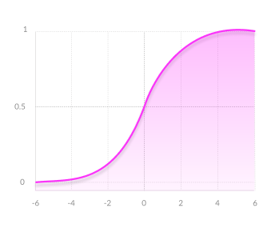
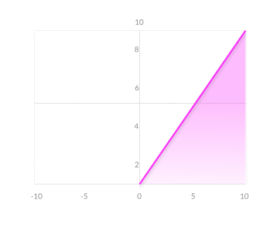
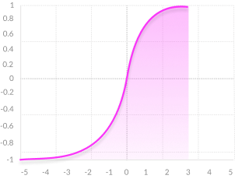
Activation Functions
sigmoid
tanh
ReLU

Slide 25
Activation Function
An Activation Function helps the model learn non-linear features. Without the activation function, it would only model linear functions which is bad in cases where the data is a non-linear data(99% of the time, the data is non-linear).
Different types of Activation functions used often:
ReLU
Sigmoid
Tanh
Leaky ReLU
Swish
Softmax

Slide 26

ReLU
The rectified linear activation function has rapidly become the default activation function when developing most types of neural networks.
Advantages :
Computational Simplicity
Representational Sparsity
Train Deep Networks

Slide 27
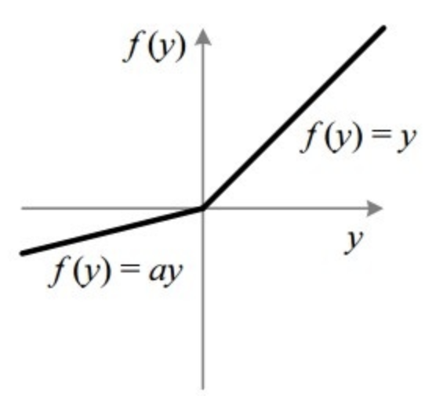
Leaky ReLU
Leaky Rectified Linear Unit, or Leaky ReLU, is a type of activation function based on a ReLU, but it has a small slope for negative values instead of a flat slope. The slope coefficient is determined before training, i.e. it is not learnt during training. This type of activation function is popular in tasks where we we may suffer from sparse gradients, for example training generative adversarial networks.

Slide 28
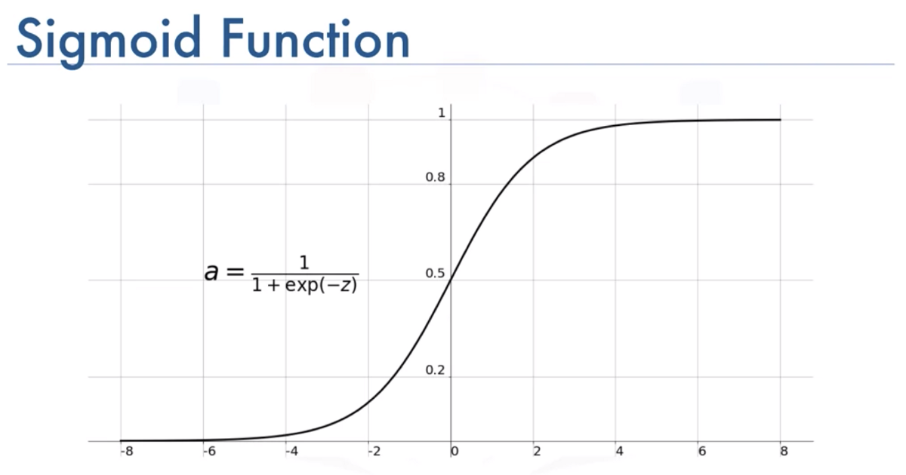
Sigmoid
The Sigmoid Function curve looks like a S-shape.The main reason why we use sigmoid function is because it exists between (0 to 1). Therefore, it is especially used for models where we have to predict the probability as an output.Since probability of anything exists only between the range of 0 and 1, sigmoid is the right choice

Slide 29
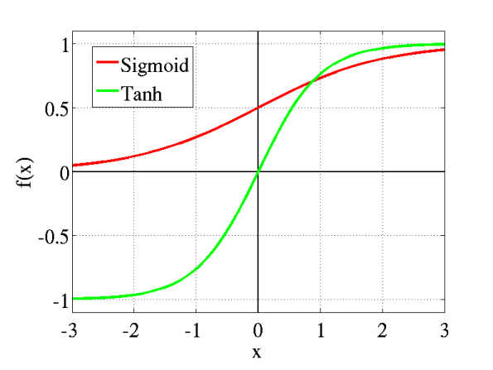
Tanh
Tanh is also like logistic sigmoid but better. The range of the tanh function is from (-1 to 1). tanh is also sigmoidal (s - shaped). The advantage is that the negative inputs will be mapped strongly negative and the zero inputs will be mapped near zero in the tanh graph. The tanh function is mainly used classification between two classes.

Slide 30
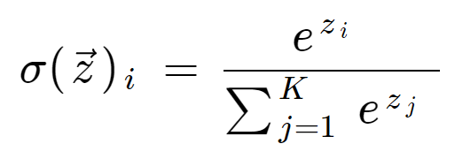
Softmax
The softmax function is a generalization of the logistic function to multiple dimensions. It is used in multinomial logistic regression and is often used as the last activation function of a neural network to normalize the output of a network to a probability distribution over predicted output classes.

Slide 31
Which is best and why?
ReLU is considered an all-rounder in terms of activation function. It is used almost everywhere in between the layers of the network but not in the output. The last activation should be chosen according to the task. If it is binary classification then use Sigmoid. If it’s multiclass classification then you have to use softmax activation. If you are using a GAN(will be discussed later) then you might need to use Leaky ReLU and Tanh. It all depends on the situation and task you are applying for.

